Slide 1

Financial (Stocks) Analytics
Top 500 Companies of India

Slide 2
Objectives
We have to answer various business questions like -
Top Companies by Market Cap (Large Cap, Mid Cap and Small Cap)
2. Total and Company-wise Market Cap
3. Top Performing Sectors by Market Cap
4. Average P/E Ratio by Sectors
5. Top & Bottom Companies By EPS
6. Overvalued companies (High P/E ratio)
7. Company-wise details like EPS, Market Cap, P/B, P/E, etc.
8. Highly volatile companies
9. Less volatile companies
10. Companies by Dividend Yield
11. Companies by EBITDA
12. Annual Sales of Companies

Slide 3
Benefits
Better Decision-Making about marketing strategies, pricing, inventory management, and expansion plans.
Improved Efficiency in sales processes, reduced costs, and increased productivity.
Competitive Advantage, helps them to increase market share.
Better Customer Insights for higher customer satisfaction and increased customer loyalty.
Increased Revenue and profitability over time.

Slide 4
Data Sharing Agreement
Sample file name (constituents-financials)
Number of Columns: 14
Number of Rows: 505
Column Names: Symbol Name, Sector, Price, Price/Earnings, Dividend Yield, Earnings/Share, 52 Week Low,
52 Week High, Market Cap, EBITDA, Price/Sales, Price/Book, SEC Filings.

Slide 5
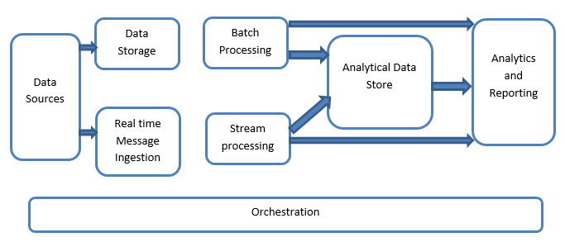
Architecture

Slide 6
Data Validation
Name Validation – Validation of files as per the DSA.
Number of Columns- Validation of number of columns present in the file, if it doesn’t match our criteria move it to particular column.
Name of Column- The name of the column is validated and should be same as given schema file. If not then adjust accordingly.
Data type of column- Data type is given in the schema file. It is validated when we insert the files into Database. If the datatype is wrong, then the file is moved to “Bad_Data_Folder”.
Null Values in Columns- If any of the columns in a file have all the values as NULL or missing, we discard such a file and move it to “Bad_Data_Folder”

Slide 7
Data Cleaning
Columns Remove:- ‘Symbol’ and ‘SEC Fillings’ columns are removed as they have no use in our analysis.
Columns Add:- ‘Annual Sales’ column is added as we have analysis related to it.
Renaming Columns:- ‘Name’ to ‘Company Name’ and ‘Price’ to ‘Market Price’
Checking and removing Null values in columns
Saving cleaned file as ‘Cleaned_finance_data.csv’

Slide 8
Model Training
Data Export from Db:
The accumulated data from db is exported in csv format for model training
Data Pre-processing
Performing EDA to get insight of data like identifying distribution , outliers, trend among data etc.
Check for null values in the columns. If present impute the null values.
Encode the categorical values with numeric values.
Perform Standard Scalar to scale down the values>

Slide 9
Prediction
The testing files are shared in the batches and we perform the same validation operations , data transformation and data insertion on them.
The accumulated data from db. is exported in csv format for prediction.
We perform data pre-processing techniques on it.
KMeans model created during training is loaded and clusters for the pre-processed data is predicted
Based on the cluster number respective model is loaded and is used to predict the data for that cluster.
Once the prediction is done for all the clusters. The predictions are saved in csv format and shared.

Slide 10
Q&A
What’s the source of data?
The data for training is provided by the client in multiple batches and each batch contain multiple files.
What was the type of data?
The data was the combination of numerical and categorical values.
What’s the complete flow you followed in this project?
Refer slide 5th for better Understanding
After the file validation what you do with incompatible file or files which didn’t pass the validation?
Files like these are moved to the achieve folder and the list of these files has been shared with the client and we removed the bad data folder.

Slide 11
What techniques were you using for data pre-processing
Removing unwanted attributes
Visualizing relation of independent variable with each other and output variable
Checking and changing Distribution of continuous values
Removing outliers
Cleaning data and imputing if null values are present.
Converting categorical data into numeric values
Scaling the data

